Slide 1

Moving Beyond the Leakages: Practical Strategies to Manage Incontinence
Nicole J. Davis, MSN, ANP-BC, GNP-BC
Adult and Gerontological Nurse Practitioner, Atlanta VA Medical Center, GRECC
PhD Student, Georgia State University
NHCGNE Patricia G. Archbold Scholar 2012-2014

Slide 2

Burdens of Incontinence

Slide 3
Goals
Discuss practical tips to manage urinary incontinence
Identify strategies to promote toileting safety, reduce risk of falls, and care for skin
Discuss strategies to manage stress related to caring for someone with UI

Slide 4

Urinary Incontinence (UI)
A leakage of urine that happens outside of a person’s control

Slide 5
UI: Causes
Abnormal changes in urinary system
Loss of mental ability
Physical disability
Uncontrolled or undiagnosed medical condition
Constipation
Side effect of medication
(Vaughan, et al, 2011)

Slide 6

UI: Common Myths

Slide 7
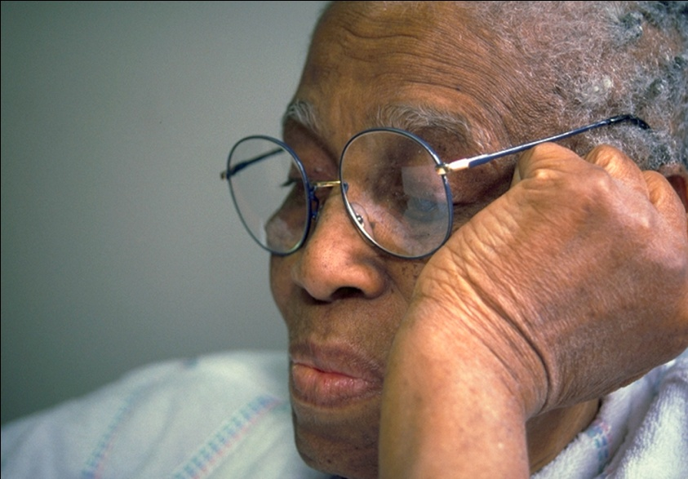
UI: Common Myths
Myth #1: Incontinence is a normal part of getting older
Fact: UI is not an unavoidable part of aging

Slide 8

UI: Common Myths
Myth #2: Very few people have UI
Fact: 200 million people throughout the world suffer with UI

Slide 9

UI: Common Myths
Myth #3: Drinking less fluids will help with the leakages
Fact: Limiting fluids can lead to dehydration, making bladder conditions worse

Slide 10
UI: Common Myths
Myth #4: Nothing can be done to help UI
Fact: UI is a treatable condition

Slide 11

UI: Common Myths
Myth #5: The person I take care of has UI, so that makes me a bad caregiver
Fact: UI in your care-recipient is not a direct reflection of your caregiving abilities

Slide 12
Toileting and Dementia
Less able to understand and respond to urge to urinate
Functional Incontinence
(Specht, 2011)
(Specht, 2011)

Slide 13
Toileting and Dementia
(Specht, 2011).
Less able to understand what everyday objects are used for
                (Specht, 2011)

Slide 14
Toileting and Dementia: What to Do
Observe for toileting cues
Paint bathroom door or toilet seat cover
Remove common objects that can be mistaken for toilet
Choose easily removable clothing
(NAFC, 2011)

Slide 15
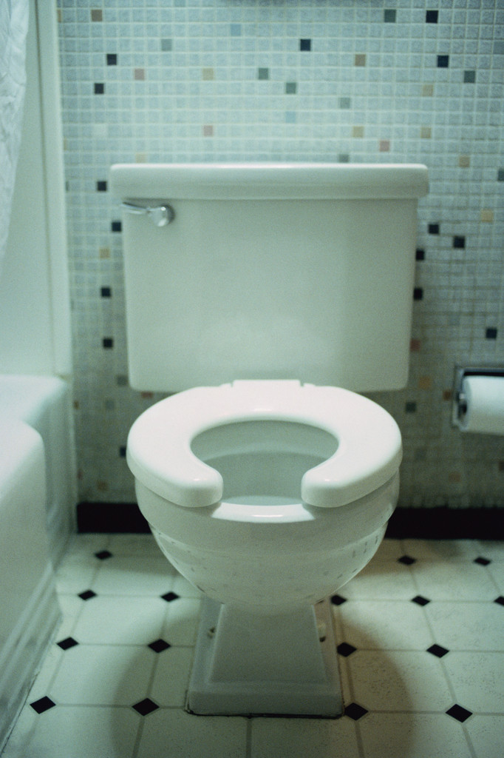
Bathroom Safety and Falls
Promote independence
Raised toilet seats
Grab bars
Non-skid floor mats
      (Bradley, 2012)

Slide 16
Bathroom Safety and Falls
Well-lighted path to bathroom
Bedside urinal or commode
Limit fluids before bed
Empty bladder before bed
(Newman & Wein, 2009; NAFC, 2011)

Slide 17

Assistive Transfers
Proper body mechanics
Toileting in public settings
(Bradley, 2012)

Slide 18

Scheduled Toileting
Toilet “by the clock”
Goal: get ahead of leakages

Slide 19

Prompted Voiding
Verbal praise for successful toileting or dryness
Goal: promote dryness and independent toileting

Slide 20




Caffeine

Slide 21

Fluid Management
6-8 eight ounce glasses
Stop drinking fluids 2-3 hours before bedtime
(Institute of Medicine, 2004; Goode, et al., 2011; Vaughan, et al, 2009)

Slide 22
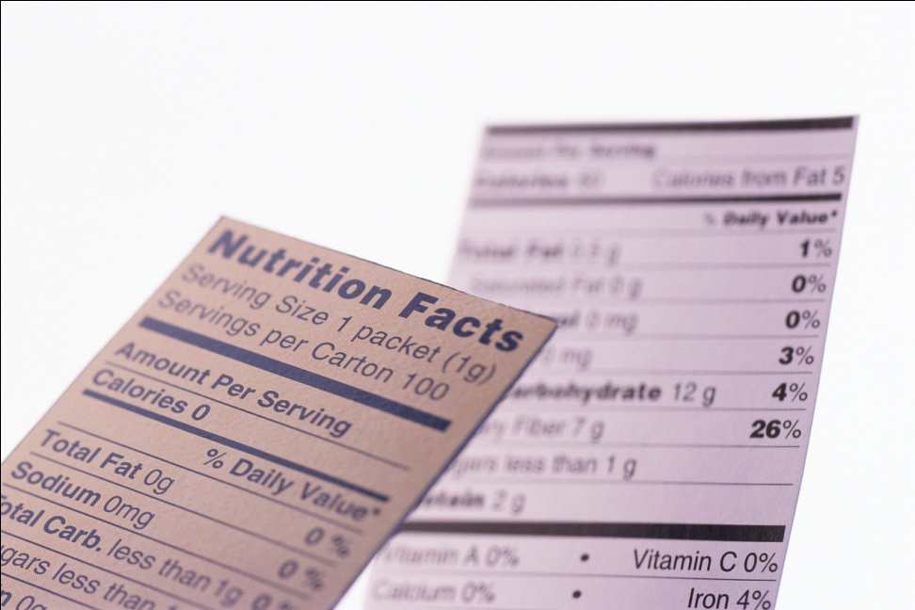
Common Bladder Irritants
Artificial sweetener
Spicy food
Tomato-based foods
Citrus
Carbonated drinks
Alcohol
(Mayo Clinic, 2011; Newman & Wein, 2009)

Slide 23
Chronic Constipation
Laxatives → habit-forming
Mineral Oil → can block Vitamin A,D,E,K
MOM → can block vitamins and minerals
(Newman & Wein, 2009)

Slide 24
Constipation Recipe
1 cup crushed 100% bran flakes
1 ½ cup canned pears in real juice
Blend. Store in Refrigerator.
Take 1 tablespoon each morning with cup of warm beverage
Be sure to drink enough fluids!

Slide 25
Skin Care
Develop routine
  Gentle cleaning
  Moisture
  Moisture barriers
Contact healthcare provider for new breakdown
(Doughty, 2006)

Slide 26
UI Product Selection: General Rules
Size
Leakage amount
Time of day
Urine vs. stool
Gender
(NAFC, 2011; Chamberlain, 2010)

Slide 27

UI Products: Cost
Medicare & private insurers
VA Benefits
Medicaid
Bulk ordering on-line
Grants

Slide 28
UI Products Cost: Who to contact?
Area Agency on Aging
Local Medicare /Medicaid Agencies
Social Services
Notes:
Share what you find

Slide 29
Managing Stress Related to UI
Be realistic
Improvements may be small
Anticipate setbacks
Take care of yourself: mind, body, spirit
Ask for help

Slide 30
Additional Resources
National Association for Continence (NAFC)
- Choosing Products
- Skin care
- Managing odor
- Finding medical specialists
http://www.nafc.org/

Slide 31
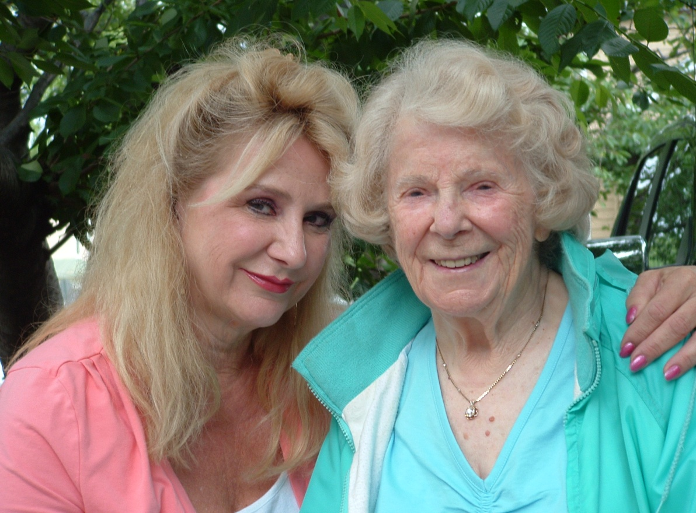
“You give but little when you give of your possessions. It is when you give of yourself that you truly give.”
~ Khalil Gibran

Slide 32
Thank you!

Slide 33
Family Caregiver Alliance is a public voice for caregivers, illuminating the daily challenges they face, offering them the assistance they so desperately need and deserve, and championing their cause through education, services, research and advocacy.
FCA established the National Center on Caregiving (NCC), to advance the development of high-quality, cost effective programs and policies for caregivers in every state in the country. The NCC sponsors the Family Care Navigator to help caregivers locate support services in their communities.
FCA also operates the Bay Area Caregiver Resource Center in the six-county San Francisco Bay Area. The staff of family counselors works closely with families caring for ill or elderly loved ones. Our services, education programs and publications are developed to offer these families direct support, vital information, and effective tools to manage the complex and demanding tasks of caregiving.
Phone numbers:
(800) 445-8106
(415) 434-3388
Address:
785 Market Street, Suite 750,
San Francisco, CA 94103
Web address:
http://www.caregiver.org
Social Media Channels:
Facebook (Family Caregiver Alliance)
Twitter (“@CaregiverAlly”)
Yelp (seeking your reviews!)
YouTube (“CAREGIVERdotORG”)

